Slide 1
Computer Graphics 8th Recitation “OpenGL: Transformations I”
Anna Shtengel
Based on slides by Michael Litvin
04.5.2015

Slide 2
Today!
OpenGL Transformations
Model-view
Projection
Viewport

Slide 3
Let’s play!
goo.gl/0xFKa

Slide 4
Why do we need it?
Model Transformation (model -> world)
Object
world

Slide 5
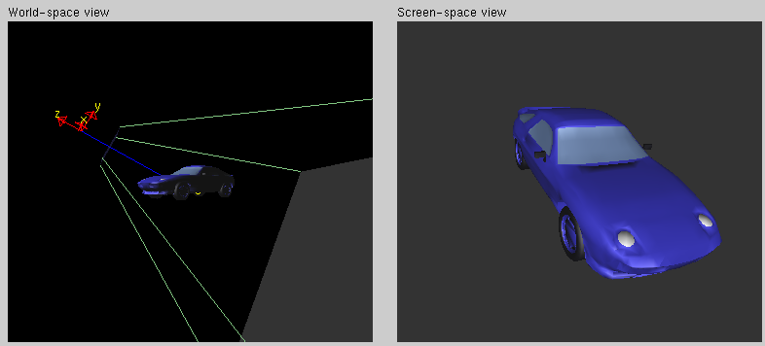
Why do we need it?
View Transformation (World -> View)

Slide 6
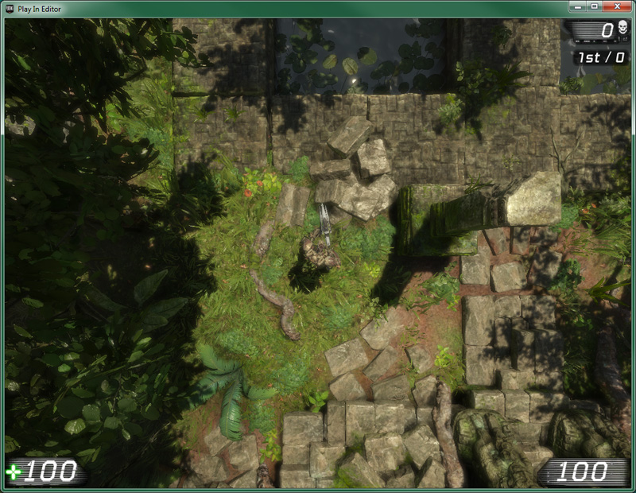

http://udn.epicgames.com/Three/CameraTechnicalGuide.html
Notes:
http://udn.epicgames.com/Three/CameraTechnicalGuide.html

Slide 7
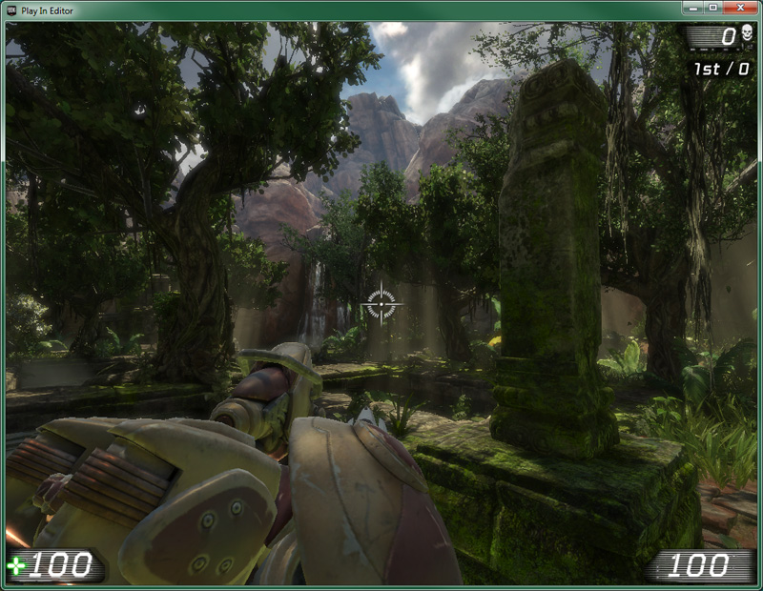

Slide 8
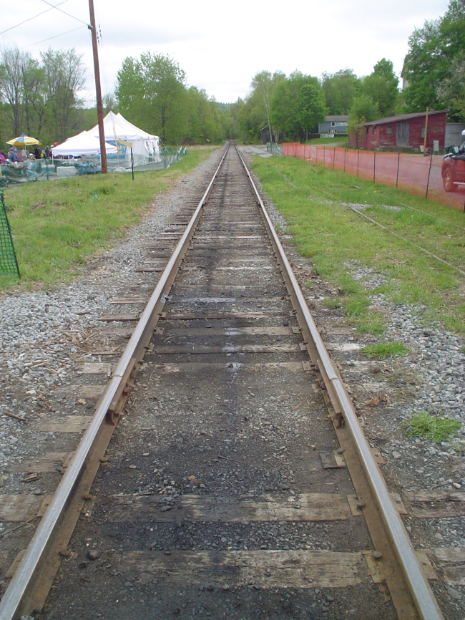
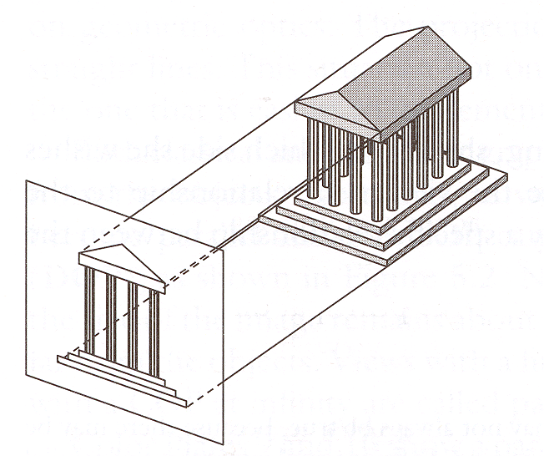
Why do we need it?
Projection Transformation (View -> Screen)

Slide 9
MODEL-VIEW
OpenGL Transformations
Some slides taken from Alan Lerner: http://www.cs.tau.ac.il/~alan/Teaching/OpenGL/OpenGL.htm

Slide 10
Graphical Pipeline
3D Geometric Primitives
3D Geometric Primitives
We Are Here
Modeling
Transformation
MODEL_VIEW
Transformation
Lighting
Lighting
And Here!
Viewing
Transformation
Projection
Transformation
Projection
Transformation
Clipping
Clipping
Scan
Conversion
Scan
Conversion
Frame Buffer
Frame Buffer

Slide 11
Transformations in OpenGL
In the pipeline every vertex is transformed by two 4x4 matrices:
ModelView
Transforms Object/Model space → World space → View space
Projection
Transforms View space → View-plane space

Slide 12
MATH: Transforming an object VS Transforming to different view
Transforming an object in a frame is done intuitively by mathematical order
rotating and then translating an object: T*R*(object)
Transforming the world to a different view – calculating viewing transformation
The view origin is at o, the axis are rotated alpha degrees CCW about axis n.
It means the world is translated –o and rotated –alpha degrees about n relatively to our view
Trans_view=Rn(-alpha)*T(-o)
Yview
alpha
y
Xview
o
X
Notes:
Transforming view = changing coordinate system

Slide 13
Manipulating Transformations
You can only manipulate the current matrix
Selecting the current matrix:
void glMatrixMode(Glenum mode);
Mode is GL_MODELVIEW or GL_PROJECTION
Example:
// Select The Modelview Matrix
glMatrixMode(GL_MODELVIEW);
// Reset The Modelview Matrix
glLoadIdentity();
// Move Left And Into The Screen
glTranslatef(-1.5f,0.0f,-6.0f);

Slide 14
Transformation Methods
glLoadIdentity – Set current matrix to the identity matrix
glTranslate – Right multiplies current matrix with a translation matrix
glScale – Right multiplies current matrix with a scaling matrix
glRotate – Right multiplies current matrix with a CCW rotation matrix with a given pivot and angle

Slide 15
Transformation Matrices
I
glTranslate(dx,dy,dz)
I
I
glScale(sx,sy,sz)
I
Axis
glRotate(α,0,0,1)
I
I
Degrees

Slide 16
Order Matters!
glMatrixMode(GL_MODELVIEW);
glLoadIdentity();
glTranslate(1,0,0);
glRotate(45,0,0,1);
drawCube(…);
glRotate(45,0,0,1);
glTranslate(1,0,0);
2
1
2
1
Notes:
http://www.cs.brown.edu/exploratories/freeSoftware/repository/edu/brown/cs/exploratories/applets/transformationGame/transformation_game_guide.html

Slide 17
Transformation Example
glMatrixMode(GL_MODELVIEW);
glLoadIdentity();
glTranslate(5,0,0);
glRotate(45,0,0,1);
glTranslate(0,5,0);
drawCube();
y
y
y
y
x
x
x
x
Notes:
http://www.cs.brown.edu/exploratories/freeSoftware/repository/edu/brown/cs/exploratories/applets/transformationGame/transformation_game_guide.html

Slide 18
Transform Order Rule of Thumb
R*p
glRotate(…);
R*T *p
glRotate(…);
glTranslate(…);
T * R* p
glTranslate(…);
glRotate(…);

Slide 19
General Methods
glLoadMatrix() – Replace current matrix with given matrix
Generallization of glLoadIdentity
glMultMatrix() – Multiply current matrix with given matrix
Generallization of glTranslate, glRotate and glScale

Slide 20
Example: Left-side multiplication
// Obtain current ModelView Transformation
double [] temp = new double[16];
gl.glGetDoublev(GL.GL_MODELVIEW_MATRIX, temp, 0);
// Rotate along the (0 0 1) in world coordinates
gl.glMatrixMode(GL.GL_MODELVIEW);
gl.glLoadIdentity();
gl.glRotated(angle, 0, 0, 1);
gl.glMultMatrixd(temp, 0);

Slide 21
Push / Pop Matrix
void glPushMatrix(void);
Pushes all matrices in the current stack down one level.
Push Matrix

Slide 22
Push / Pop Matrix
void glPopMatrix(void);
Pops the top matrix off the stack, destroying the contents of the popped matrix. What was the second-from-the-top matrix becomes the top matrix.
Pop Matrix

Slide 23
Push / Pop Matrix
render_car()
{
glTranslatef( c_x, c_y, c_z);
render_car_body();
glPushMatrix();
glTranslate( f_x, f_y, f_z);
glPushMatrix();
glTranslate( l_x, l_y, l_z);
render_wheel();
glPopMatrix();
glPushMatrix();
glTranslate( r_x, r_y, r_z);
render_wheel();
glPopMatrix();
glPopMatrix();
. . .
}
So why does OpenGL do matrix multiplication opposite to the math?

Slide 24
Model-View
ModelView used to:
place objects in the world
specify viewpoint
Two approaches to describe View:
Transformation
Representation
gl.glMatrixMode(GL.GL_MODELVIEW);
gl.glLoadIdentity();
// View transformation
…
// Model Transformation
…

Slide 25
View (transformation approach)
The “Camera” resides at the center of the axes and directed towards the negative Z axis
Instead of moving the “Camera” we move the world.
up
Y axis
Center
-Z axis
(0,0,0)
front
eye
X axis

Slide 26
View Example
gl.glMatrixMode(GL.GL_MODELVIEW);
gl.glLoadIdentity();
gl.glRotated(45,1,0,0);
gl.glTranslated(0,-8,-10);
(0,8,10)
Y axis
-Z axis
X axis
Notes:
Trans=R*T
T-make 0,8,10 the origin
R-the z’ of the camera looks -45 degrees CW about X in the world. This means the world is rotated 45 degrees CCW about X w.r.t the camera

Slide 27
View (representation approach)
void gluLookAt( eyeX, eyeY, eyeZ,
centerX, centerY, centerZ, upX, upY, upZ);
Defines a viewing matrix and multiplies it to the right of the current matrix.
The eye values define the viewpoint.
The center values defines the point of interest.
The up values indicate which direction is up.

Slide 28
View - Look At
gl.glMultMatrix(M);
gl.glTranslated(-eyeX,-eyeY,-eyeZ);
up
center
front
eye
right
Notes:
T_view=M*T(-eye)

Slide 29
Drawing with Model-View
redraw()
{
glMatrixMode(GL_MODELVIEW)
glLoadIdentity()
// Camera space
gluLookAt(…) // Set view
// World space
glTranslate(…) // Set Model
// Object space
}
Notes:
View
World
Model

Slide 30
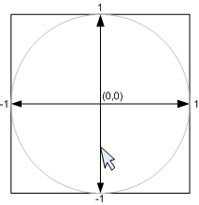
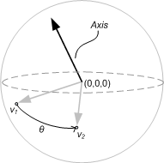
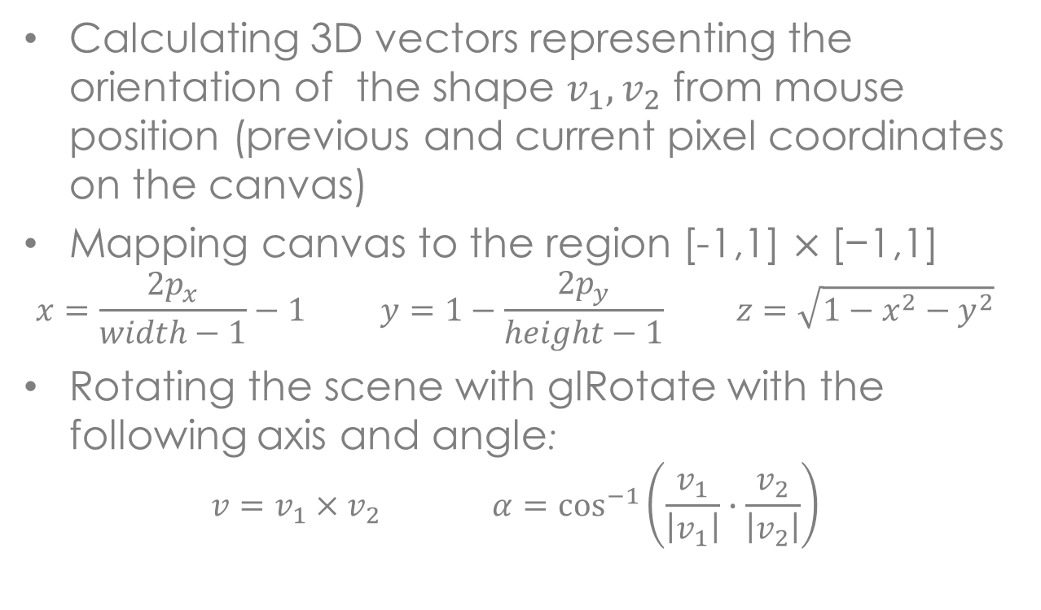

Trackball - Rotate a scene using the mouse
Calculating 3D vectors representing the orientation of the shape $v_{1},v_{2}$ from mouse position (previous and current pixel coordinates on the canvas)
Mapping canvas to the region [-1,1] $×\text{[−}\text{1,1}\text{]}$
$$x=\frac{2p_{x}}{width−1}−1 y=1−\frac{2p_{y}}{height−1} z=\sqrt{1−x^{2}−y^{2}}$$
Rotating the scene with glRotate with the following axis and angle:
$$v=v_{1}×v_{2} α=\cos^{−1}\left(\frac{v_{1}}{\left|v_{1}\right|}∙\frac{v_{2}}{\left|v_{2}\right|}\right)$$
$$α$$
Notes:
This is in the view frame!

Slide 31
Next week: Projections
OpenGL Transformations II

